Slide 1
Solar Powered Mesh Network
Jeff Ruvinsky, Marek Smaciarz,
Charles Currier, James Atkins

Slide 2
Our Mission
Make a simple but efficient mesh network
Keep track of data such as temperature within a large location (e.g. campus)
Reliable data and hardware that can be used for a long period of time
Used Processing sketch to record temperature in Fahrenheit

Slide 3
Hardware And Software Used
Xbees
Custom cases with solar panels
TMP36 temperature sensors
Processing sketch to read and interpret the data

Slide 4
Flexible Case Design
Robust plastic enclosure
ABS main body, PLA front ring, & acrylic back plate
Front rings color coded for ease of identification
Multi-surface mounting via interchangeable pads
1” suction cups on 8-32 studs included for smooth surfaces
Adaptable for future expansion
Prototype units include exposed rear bread board with 5v power
Default configuration includes XBee radios & temperature sensors
3D printing, CNC machining, & laser cutting make customization easy

Slide 5
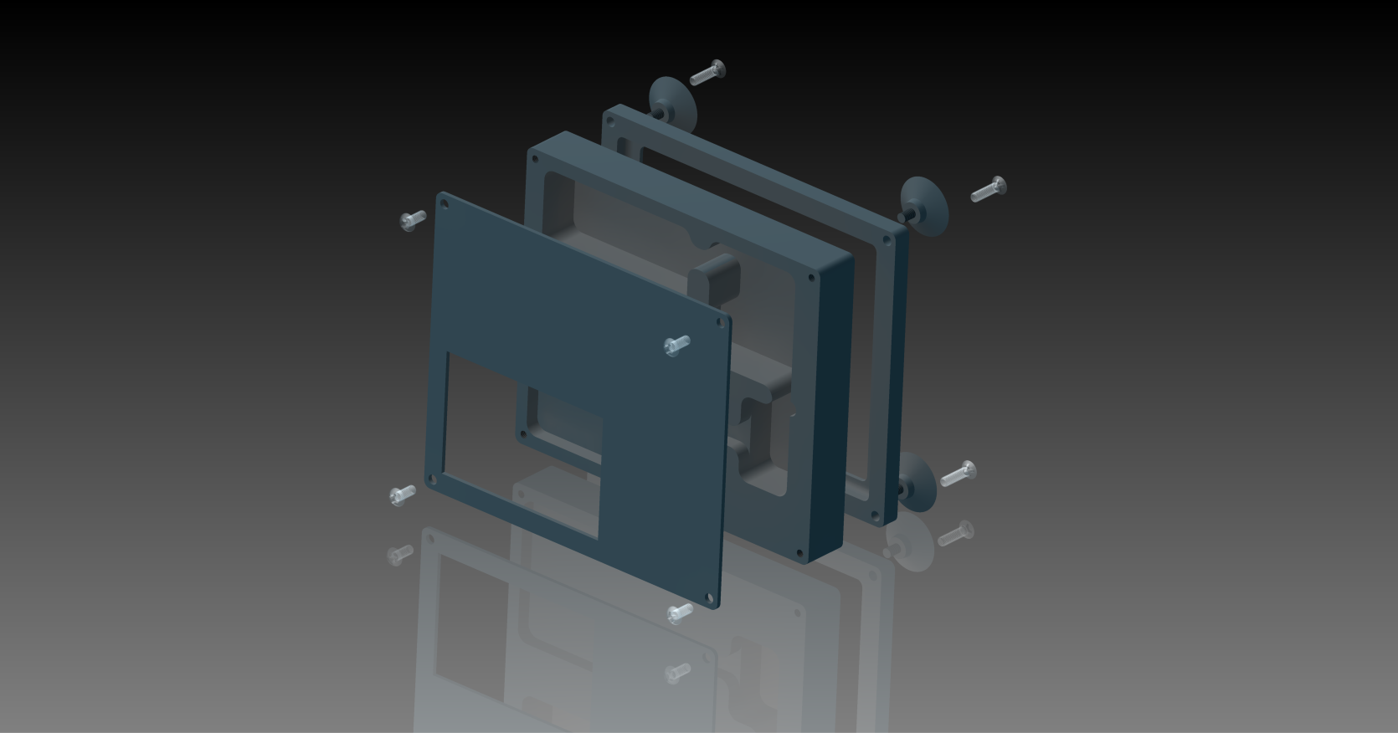
Enclosure Model

Slide 6

Xbee
Xbees are radio modules
Made by Digi International
These modules can be used to transmit and receive data over a mesh, star and point to point network
We programmed them to use a mesh network
Xbees are like a mixture of bluetooth and wi-fi, but those technologies are not as efficient as Xbee

Slide 7
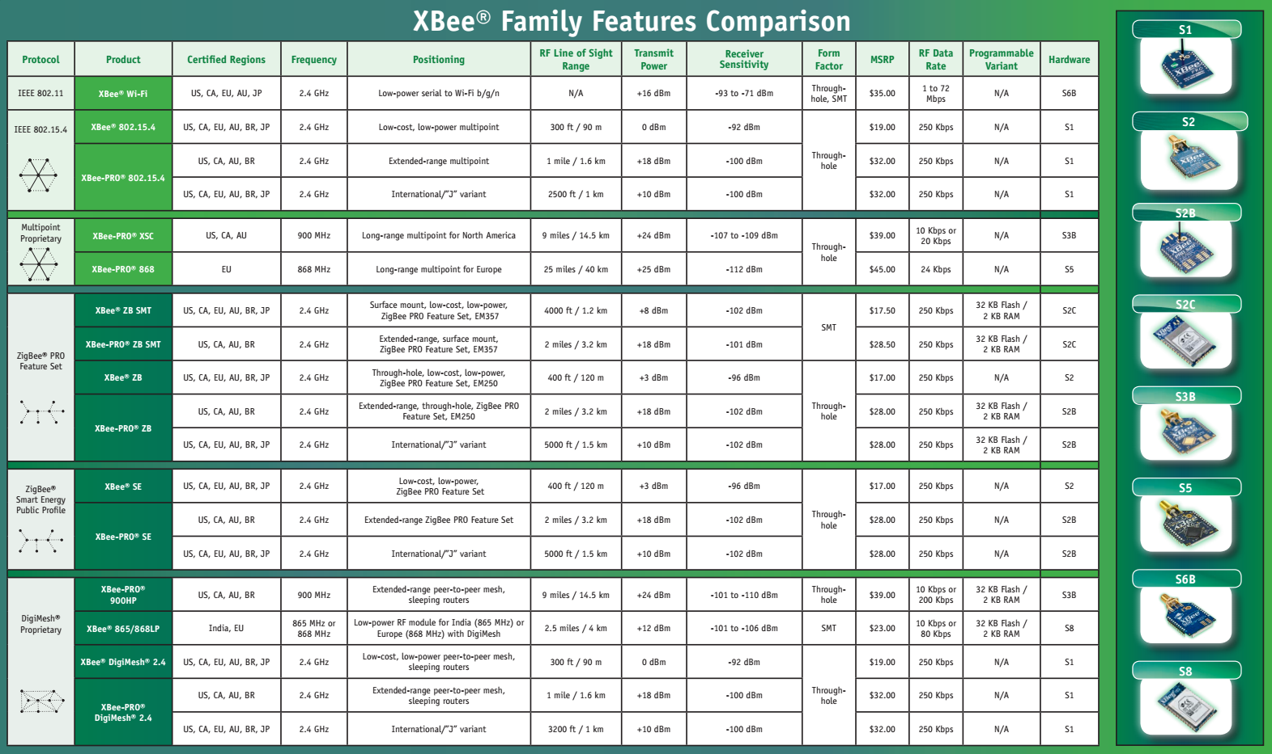

Slide 8
ZigBee
ZigBee is a specification for a suite of high level communication protocols based on IEEE 802.15 standard
IEEE 802.15 standard specifies the physical layer and media access control for low-rate wireless personal area networks

Slide 9
Solar Powered Mesh Network Project
A mesh network using Xbees
Transferred temperature data between the Xbees
Write up a processing sketch to display the data the Xbees are collecting
Make custom built cases with solar panels and rechargeable batteries for a reliable and long-lasting power source

Slide 10
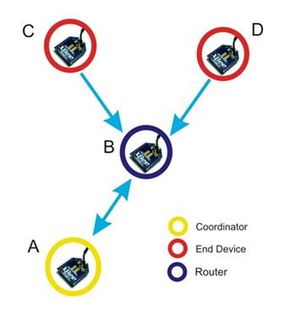
Why Mesh?
A mesh network is a topology that has many nodes that all communicate with each other to transfer and receive data
Xbees could be programmed to different topologies such as point to point, star, and mesh

Slide 11
Xbee Sleep Mode
Sleep modes to effectively reduce power consumption and extend battery life
During sleep cycles, a base node can hold messages for sleeping remotes
When the remotes wake from sleep, a poll request is sent to the base or the base requests information from the remote radio

Slide 12
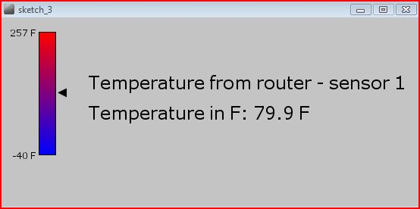
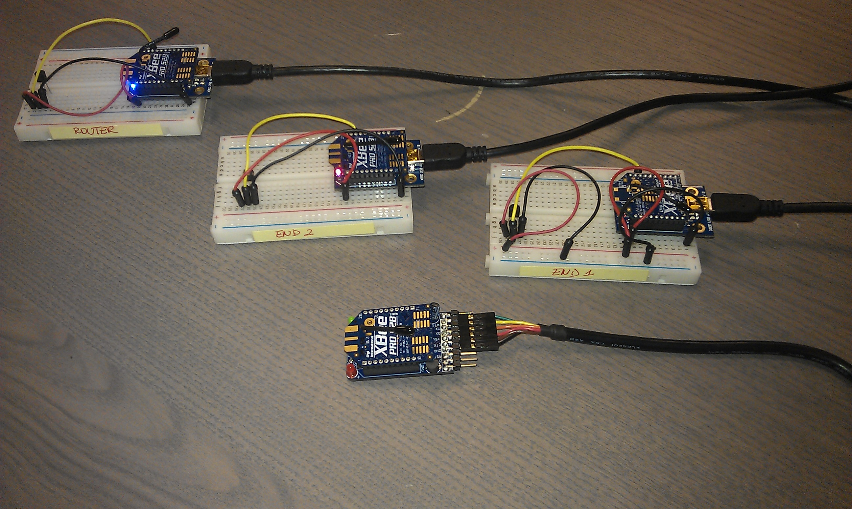
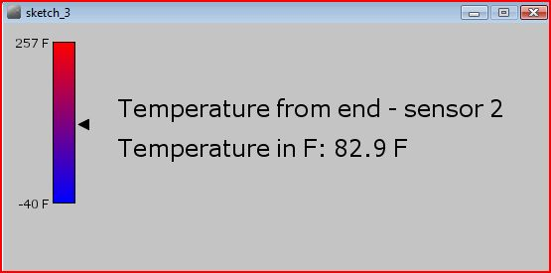
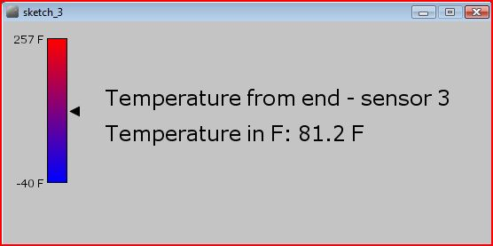
Processing Software & Mesh

Slide 13
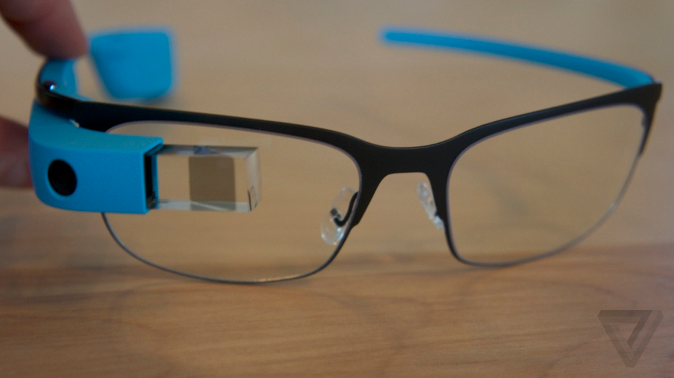
Integrating technologies
Can collect data into database
Can be integrated with Google Glass, Android or iOS

Slide 14
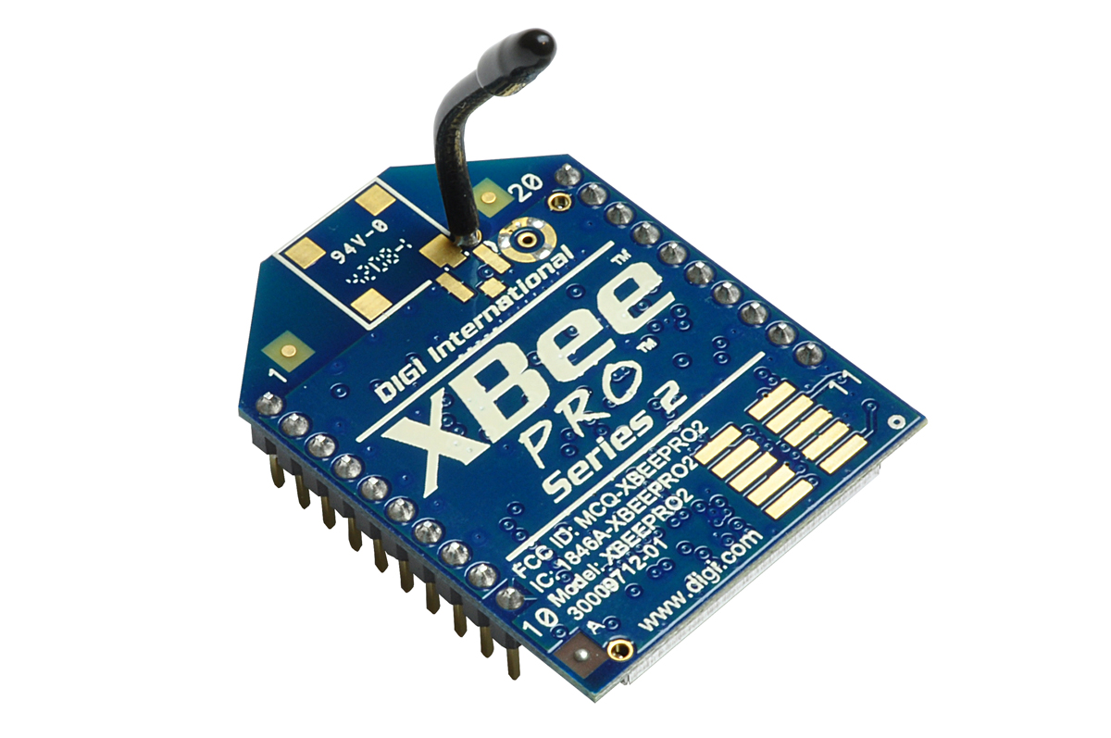
Benefits Of The Solar Mesh Sensors
Keep track of various sensors data within a building or campus
No need to worry about batteries dying
Easy to maintain and inexpensive

Slide 15
Works Cited
Digi International Inc. (n.d.). Digi. Retrieved from XBee: http://www.digi.com/xbee
Digi International Inc. (n.d.). Digi. Retrieved from ZigBee® Wireless Standard: http://www.digi.com/technology/rf-articles/wireless-zigbee

